Slide 1

- Web platform Review For Image Annotation
Tanvir Ahmed (1410982042)
CSE499A.10

Slide 2
What is Supervisely?
Supervisely is an online service by deepsystems.ai, created for dataset management, annotation and preparation to Deep Learning.
It helps people with and without machine learning expertise to create state-of-the-art computer vision applications.
Supervisely was first developed at deepsystems.ai as a solution to deal with everyday task of large datasets annotation.
The name Supervisely comes from machine learning term supervised learning — when we use a known dataset (called the training dataset) to make predictions.
Supervisely is all about datasets and using them to build models.

Slide 3
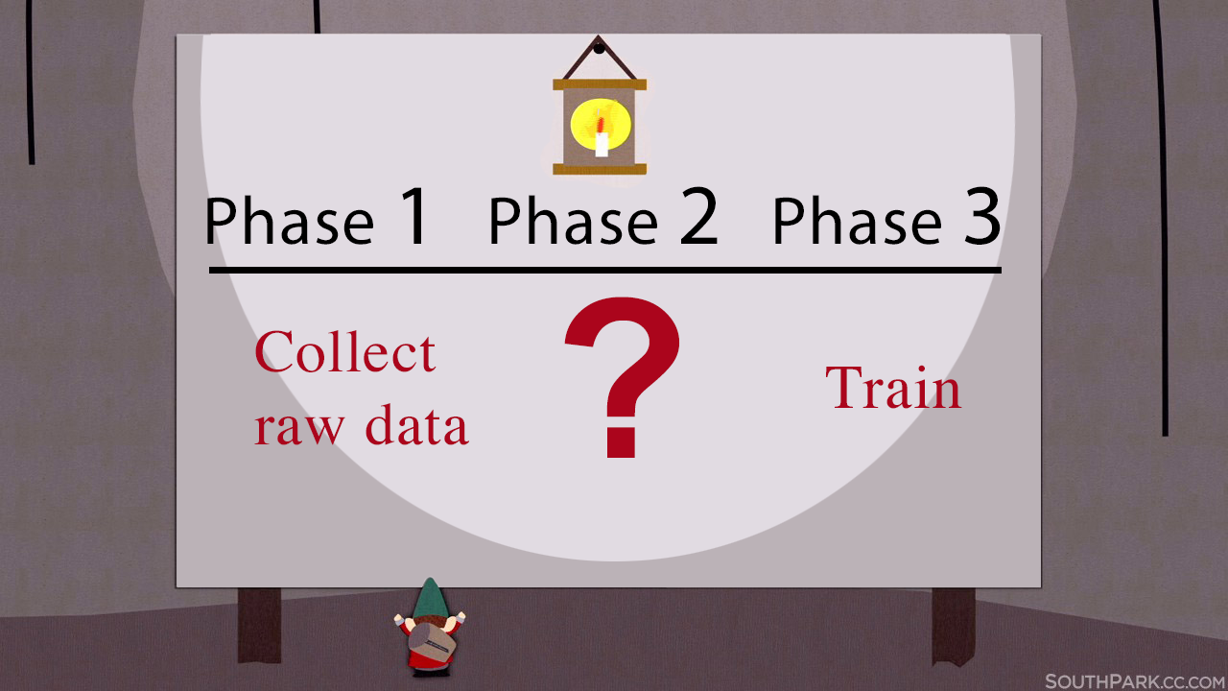
To create AI solutions for various business sectors and apply state-of-the-art models first it needs to collect data, combine it with open-source datasets, annotate and prepare it for training. Usually it takes a lot of time!
To make things easier deepsystems.ai had to come up with a solution. They wanted to create a place where anyone can go through every step of dataset preparation: from data to neural network model. So they created a service called Supervisely!

Slide 4
What’s inside?
So how exactly Supervise.ly can help fellow data scientists?
Online service to work with data. Keep and access their data anywhere, with backups and handy tools.
Datasets import. Upload their own data or automatically covert popular open-source datasets — it includes many ready-to-go configurations.

Slide 5
Annotation tool. Annotation of a single image takes up to 30 minutes: it’s important to have a handy and practical tool. Supervisely supports hot keys, both vector and bitmap figures, filtering and captioning and a lot more in a web-based solution.

Slide 6
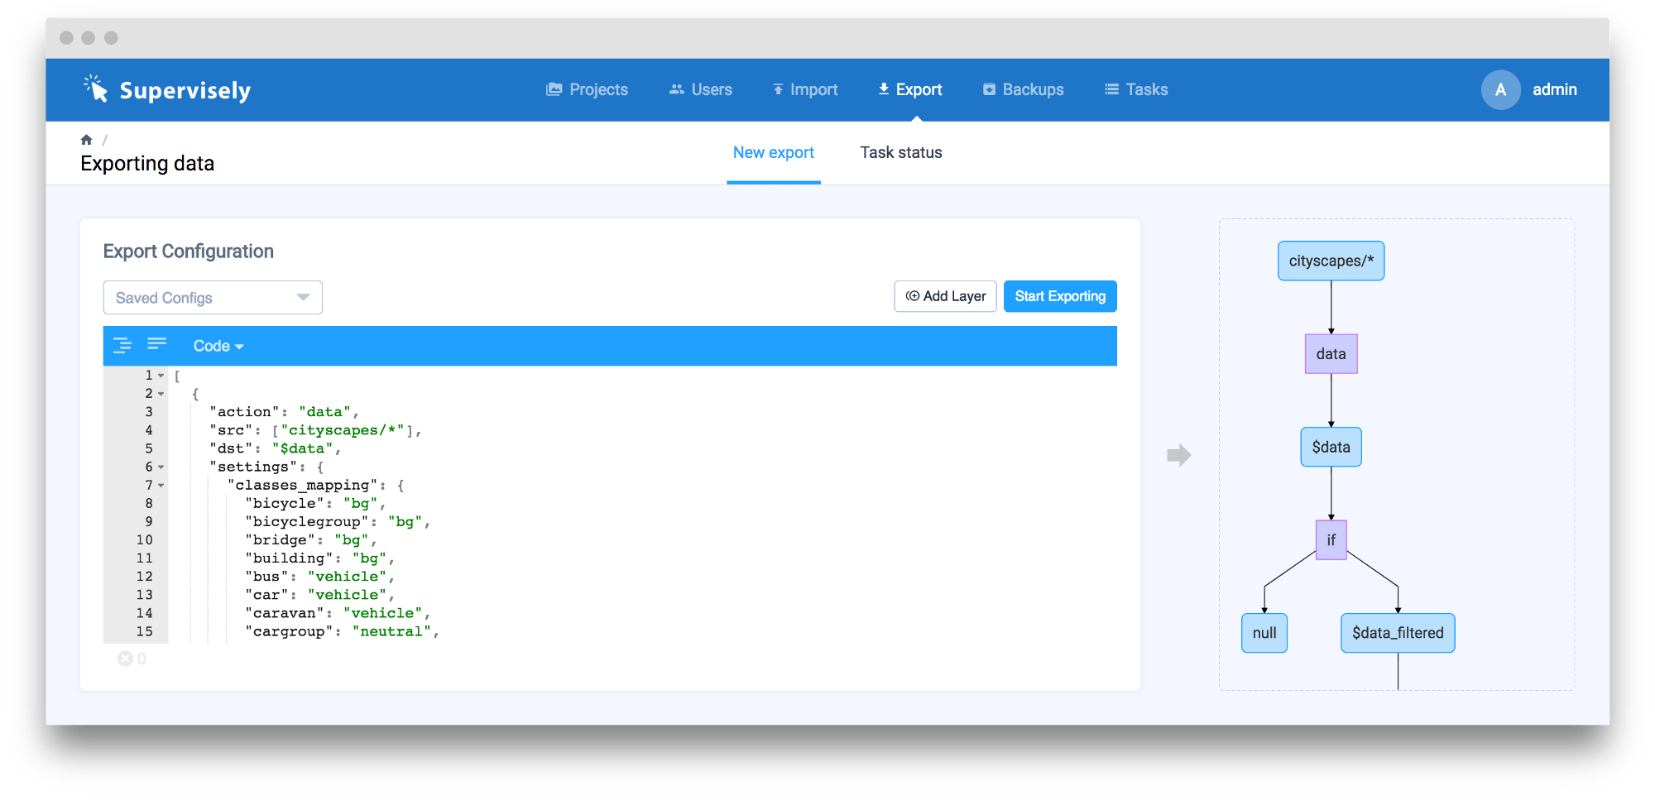
Smart export. Keep datasets in one place and prepare them together! No more coding: use simple and plain JSON-configuration to make filtering, resizing, augmentation, train-validation splitting, combining multiple datasets in one — and save results in popular ready to train frameworks formats.

Slide 7
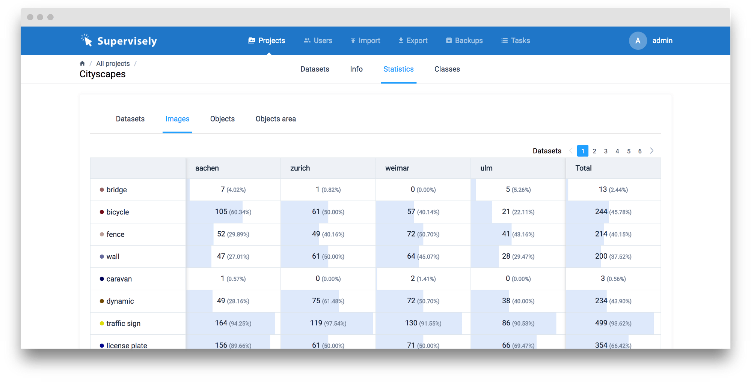
Statistics. It helps people to know their data well so that they won’t face unexpected trouble during training. Things like class imbalance problem can make ones day worse if not prepared.

Slide 8
Role management. Enterprise users will appreciate multiple accounts, access permissions and activity log. For example, configure different rights for m-turkers, in-house annotators and data scientists.
Integrations. Combine the power of well-known tools like Amazon Mechanical Turk with features of Supervisely.

Slide 9
How does it work?

Slide 10
For Whom?
Students and researchers will like the simplicity of managing open-source datasets. Besides, for non-commercial purposes it’s absolutely free.
Business and experts can have a single place to keep their valuable information safe and use the advantages of online annotation. If privacy is a question, no problems — one can have Supervisely at ones own servers.

Slide 11
Thank you

